Slide 1
WEEK 3 LESSON1
CLASSIFICATION OF MATERIALS

Slide 2
PROPERTIES OF MIXTURES AND PURE SUBSTANCES
A mixture is a matter that contains two or more pure substances and have variable composition.
Examples of mixtures: air, food we eat, glass steel etc
Materials can be classified as heterogeneous and homogeneous mixtures
Homogeneous materials: Materials that have uniform composition throughout
E.g. raw sugar, salt water and window glass
Solution is a homogeneous mixture. A solution consists of a solute in a solvent. As solute is distributed throughout the solvent, solutions are classified as homogeneous.

Slide 3
The other type of homogeneous material is a pure substance.
Pure substances are substances that are made up of only one type of particle and have constant composition.
Pure substances can be divided into two groups namely elements and compounds.
Elements are pure substances that are composed of only one type of atom e.g.
Compounds are pure substances that are composed of more than one type of atom chemically combined in fixed proportions.

Slide 4
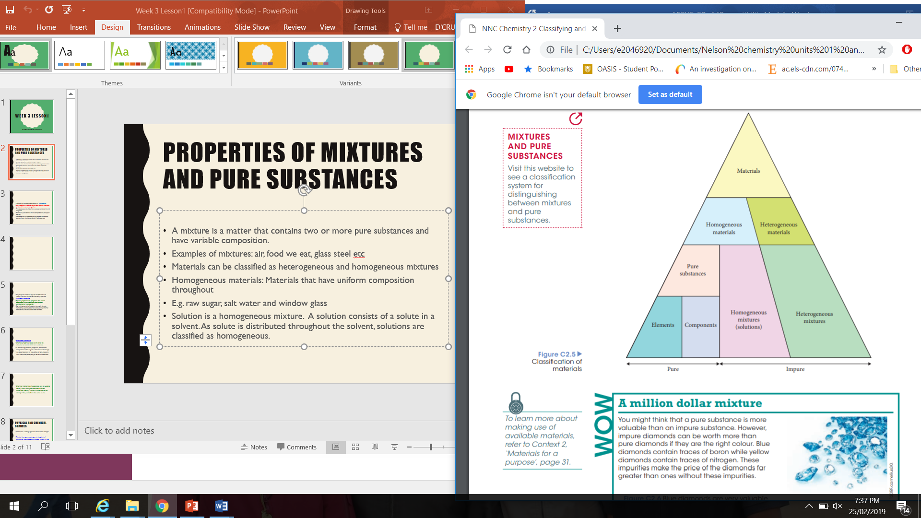

Slide 5
PROPERTIES OF MIXTURES AND PURE SUBSTANCES
Properties of materials can be divided into two groups. They are physical & chemical properties.
A pure substance will always have a well defined and constant boiling point and melting point.
A mixture of water and various soluble salts will boil at some temperature above 100 degree Celsius, and freeze at some temperature below 0 degree Celsius.
The density of a pure substance is fixed, while that of a mixture will vary.
Pure substance has a constant and well defined set of physical properties like hardness, electrical conductivity and colour.
In mixtures the above properties will vary

Slide 6
Chemical properties
Chemical properties relate to the ability of a substance to react to form new substances.
In determining chemical properties, the chemical composition of the original substance should change.
e.g. decomposition by heat, effect of light, reactions with water, acids, bases, oxygen & other substances.

Slide 7
PHYSICAL AND CHEMICAL CHANGES
Matter can undergo physical & chemical changes
Physical changes are changes in the physical properties, such as density, state & colour. In this change there is no change in the chemical composition of the substance. E.g. freezing water.

Slide 8
Chemical change:
A change in which at least one new substance is formed is a chemical change. The chemical composition of the original substance has changed and the new substance formed has different chemical & physical properties.

Slide 9
Indications of chemical change
Formation of a solid ( called a precipitate) is formed.
E.g. when lead nitrate & sodium iodide solutions are mixed, a bright yellow solid is produced.
Formation of a gas
e.g. when magnesium metal is dropped into hydrochloric acid, a gas is produced.
A change in colour
E.g. when iron is exposed to air & water, it turns into reddish brown

Slide 10
A significant change in temperature ( energy is absorbed or released)
E.g. When sodium is dropped into water, heat is given off
An insoluble solid disappears
E.g. copper in nitric acid produces a blue solution and a brown gas
Do Question EC set: 4, Page: 25 ( Questions: 1&3)

